Slide 1

Defending and Securing Systems
Monitoring and Securing the DFI Environment

Slide 2
Securing a Computer System
Scenario:
Douglas Financials Inc (DFI from here forward) has experienced successful growth and as a result is ready to add a Security Analyst position. Previously Information Security responsibilities fell on our System Administration team. Due to compliance and the growth of DFI we are happy to bring you on as our first InfoSec employee! Once you are settled in and finished orientation we have your first 2-Weeks assignments ready.

Slide 3

Week 1

Slide 4
Connect - Instructions
All of the subsequent steps will take place in the DFI environment. Use the Windows 10 workstation to connect with the Windows server provided. [Please Provide Screenshots on the next slide as evidence that you completed this step.]

Slide 5
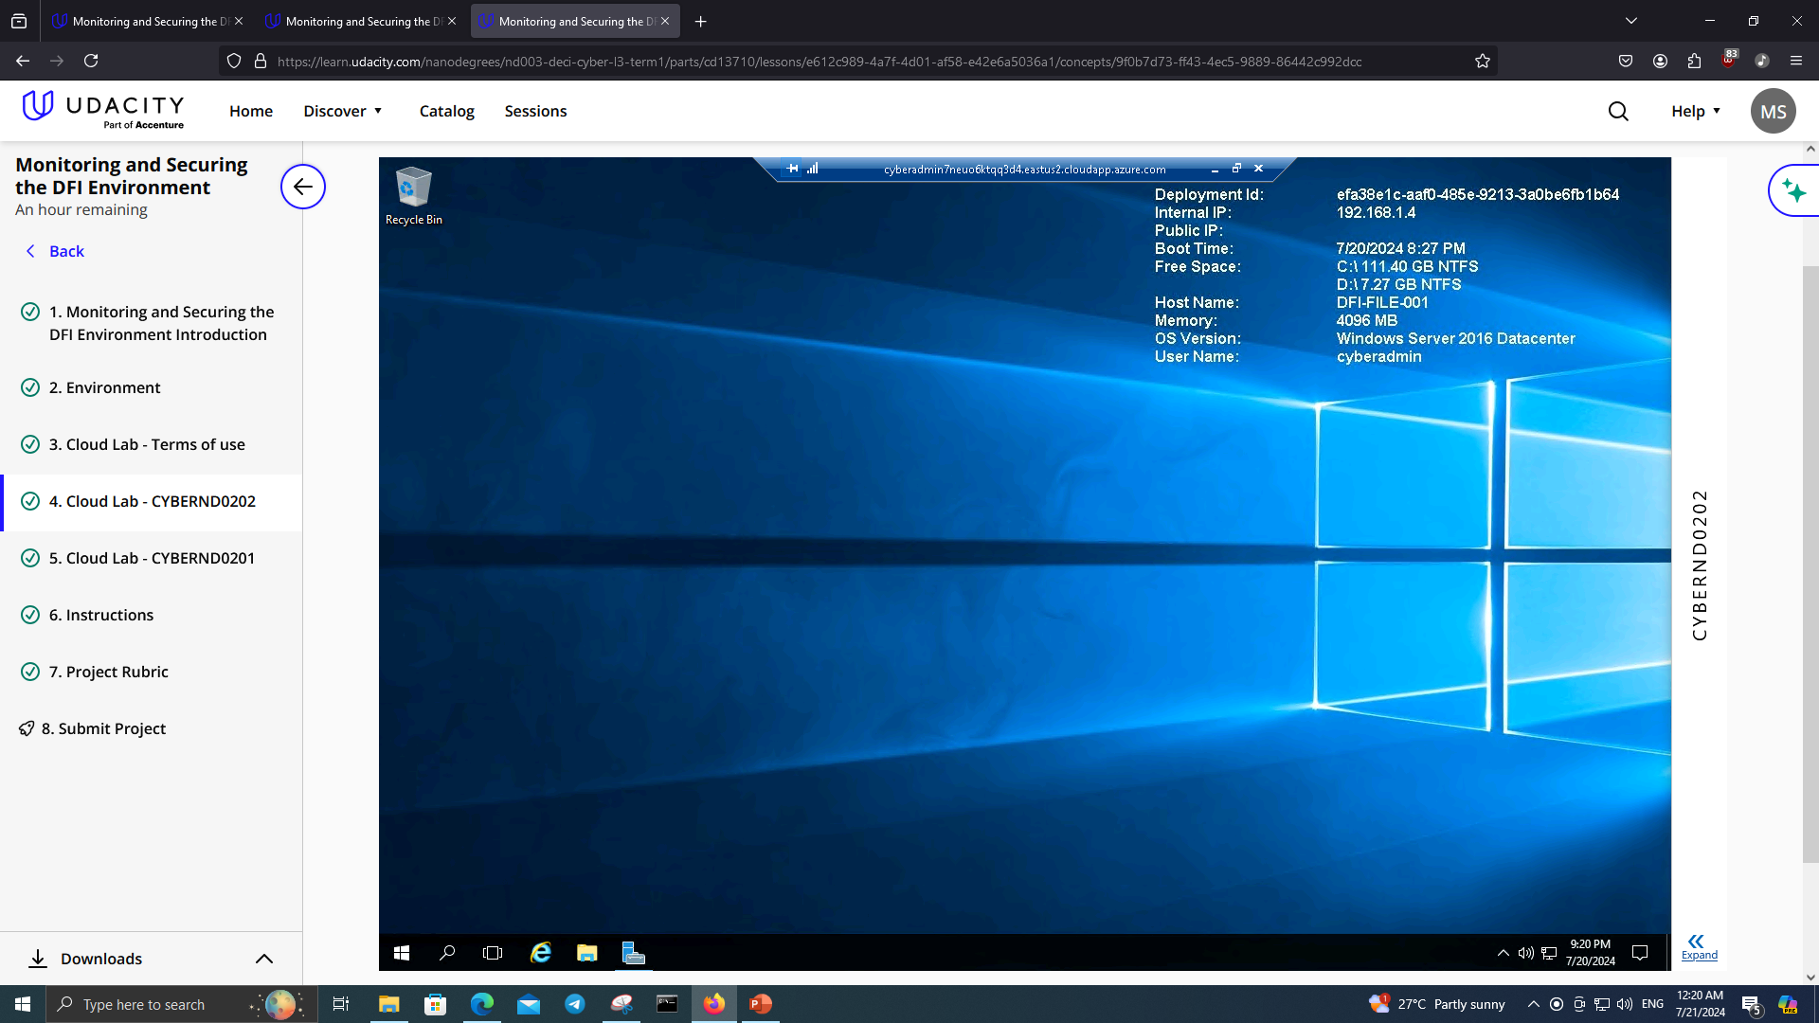
Connect - Evidence
[Please Provide Screenshots here as evidence that you completed the step listed on the previous slide. You may need to duplicate this slide to include all of your screenshots]

Slide 6
2. Security Analysis Instructions
DFI has an excellent SysAdmin team, but they have been focused on system reliability and scaling to meet our growing needs and as a result, security may not be as tight as we'd like. Your first assignment is to familiarize yourself with our file and application servers. Please perform an analysis of the Windows server and provide a written report detailing any security configuration issues found and a brief explanation and justification (5 sentences at least) of the changes you recommend. DFI is a PCI compliant organization and will likely be Sarbanes-Oxley in the near future. Use NIST, Microsoft, Defense-in-Depth, Principle of Least Privilege and other resources to determine the changes that should be made. Note changes can be to add/remove/change services, permissions and other settings. Defense-in-Depth documentation. NIST 800-123 (other NIST documents could also apply.) Looking at the following requirements, specifically: Folder Permissions (that are incorrectly granted) Roles Changes (disabled/enabled) Services changes (disabled/enabled) Tip: Do not miss the security permissions on the HR Directory. Write your analysis on the next slide.

Slide 7
2. Security Analysis Evidence
Write your analysis below.
1 | Incorrect Folder Permissions on HR Directory, normal users are allowed read & execute permissions, this poses a massive security risk to data privacy and security (confidentiality) and must be mitigated by denying access to users. Device health attestation should be enabled, IIS should be disabled, as it increases the attack surface for hackers. (Roles) Remote Registry and Themes should be removed from Services, the former is too much of a risk and the latter is useless and might open vulnerabilities, while Active Directory services should be enabled for management and WSUS for scalability.

Slide 8
3. Firewall Rules - Instructions
DFI does not have a dedicated networking department just yet, once again these tasks normally fall under the SysAdmin group. Now that we have you as a security professional, you'll take over the creation of our firewall rules. We recently entered into a new partnership and require new IP connections. Using Cisco syntax, create the text of a firewall rule allowing a new DFI partner WBC International, access to DFI-File-001 & DFI-File-002 access via port tcp-9082. The first partner's IP is 21.19.241.63 and DFI-File-001's IP is 172.21.30.44. The second partner's IP is 21.19.241.64 and DFI-File-002's IP is 172.21.30.45. For this exercise assume the two IP objects have not been created in the firewall. Note* Use DFI-Ingress as the interface for the rule. For documentation purposes, please explain in 2-3 sentences the syntax for non-technical management on the change control board that meets weekly. Write the text of your firewall rule and explanation on the next slide.

Slide 9
3. Firewall Rules - Evidence
Write the text of your firewall rules and explanation below.
 | First Partner’s Firewall rule: access-list DFI-Ingress extended permit tcp host 21.19.241.63 host 172.21.30.44 eq 9082 Second Partner’s Firewall rule: access-list DFI-Ingress extended permit tcp host 21.19.241.64 host 172.21.30.45 eq 9082 I allowed both partners access from their computers to DFI-File-001 and DFI-File-002 (using their IP) respectively through our firewall using Cisco’s Syntax.

Slide 10
4. VPN Encryption Recommendation
Instructions and Evidence
DFI is creating a payroll processing partnership with Payroll-USA, this will involve creating a VPN connection between the two. Research, and in in 3 to 5 sentences, recommend and justify an encryption solution for the connection that is using the latest available encryption for Cisco. Use the Cisco documentation as a guide
 | Write your VPN Encryption Recommendation here. I recommend using AES-GCM, it’s an NGE (Next Generation Encryption) which should meet security and scalability requirements for our company for around 20 years, it is also believed to be QCR (Quantum Computer Resistant) meaning it’s safe in the future.

Slide 11
5. IDS Rule - Instructions
The System Administrator gave you a heads up that DFI-File-001 with an IP address of 172.21.30.44 has been receiving a high volume of ICMP traffic and is concerned that a DDoS attack is imminent. She has requested an IDS rule for this specific server. The VoIP Administrator is also concerned that an attacker is attempting to connect to her primary VoIP server which resides at 172.21.30.55 via TFTP. She has requested an IDS rule for this traffic. For documentation purposes, please explain the syntax in 3-5 sentences for non-technical management on the change control board that meets weekly. Write your answers on the next slide.

Slide 12
5. IDS Rule - Evidence
Write your answers below.
 | Write your System Admin rule and explanation here. alert icmp any any -> 172.21.30.44 any (msg: “DDoS Attempt via ICMP”; threshold: type both, count 100, seconds 60; sid:1000001;) This rule alerts the System Admin for a DDoS attempt to impact our availability by using a certain acceptable threshold then warning her.
 | Write your VoIP Admin rule and explanation here. alert udp any any -> 172.21.30.55 69 (msg: “VoIP Server Connection Attempt”; sid:1000002) This rule alerts the VoIP Admin for any connection attempt to her primary server by checking for TFTP traffic, then warning her.

Slide 13
6. File Hash Verification - Instructions
A software vendor has supplied DFI with a custom application. They have provided the file on their public FTP site and e-mailed you directly a file hash to verify the integrity and authenticity. The hash provided is a SHA256. Hash: 7805EC4395F258517DFCEEED2B011801FE68C9E2AE9DB155C3F9A64DD8A81FF6 Perform a file hash verification and submit a screenshot of your command and output. The File is stored on the Windows 2016 Server in C Drive under DFI-Download. [Place your screenshot verification on the next slide.]

Slide 14
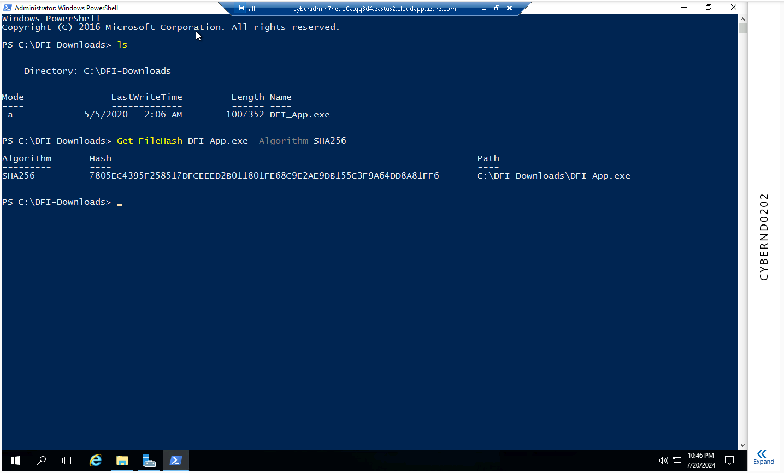
6. File Hash Verification
Place your screenshot verification below.

Slide 15
Week 2

Slide 16
7. Automation - Instructions
Now that you've performed a light audit and crafted Firewall and IDS Signatures we're ready for you to make some additional recommendations to tighten up our security. The IT Manager has tasked you with some introductory research on areas that could be improved via automation. Research and recommend products, technologies and areas within DFI that could be improved via automation. Recommended areas are: SOAR products and specifically what could be done with them Automation of mitigation actions for IDS and firewall alerts. Feel free to elaborate on other areas that could be improved. Complete the chart on the next slide including the area/technology within DFI and a proposed solution, with a minimum of 3 areas. Provide a brief explanation (at least one sentence each) for your choices.

Slide 17
7. Automation - Evidence
Complete the chart below.
 | DFI Area/Technology | Solution | Justification for Recommendation
 | Multiple Security Products | SOAR Solutions (I recommend Splunk Phantom) | Instead of having to open a ton of different tools to achieve different security tasks, we can merge them all into one to streamline efforts.
 | IDS/Firewall not taking action | Next-Gen Firewalls | IDS/Firewall is a passive mechanism, getting NGEs means we can respond proactively, since they include IPSes we can merge and improve our security.
 | Log Management | SIEM Solutions | Having to read logs was frustrating, especially missing important ones and having them deleted. This will fix that issue by merging all logs into a uniform and clean system.

Slide 18
8. Logging RDP Attempts - Instructions
The IT Manager suspects that someone has been attempting to login to DFI-File-001 & DFI-File-002 via RDP. Prepare a report that lists unsuccessful attempts in connecting over the last 24-hours & 12 hours respectively. Using Powershell or Eventviewer, search the Windows Security Log for Event 4625 & 4626 respectively. Export to CSV. For your deliverable, open the CSV with Notepad and take a screenshot from your personal computer for your explanation. Then in 3-5 sentences, explain your findings, recommendations and justifications to the IT Manager. Place your screenshot on the following slide and the explanation on the slide after your screenshot.

Slide 19
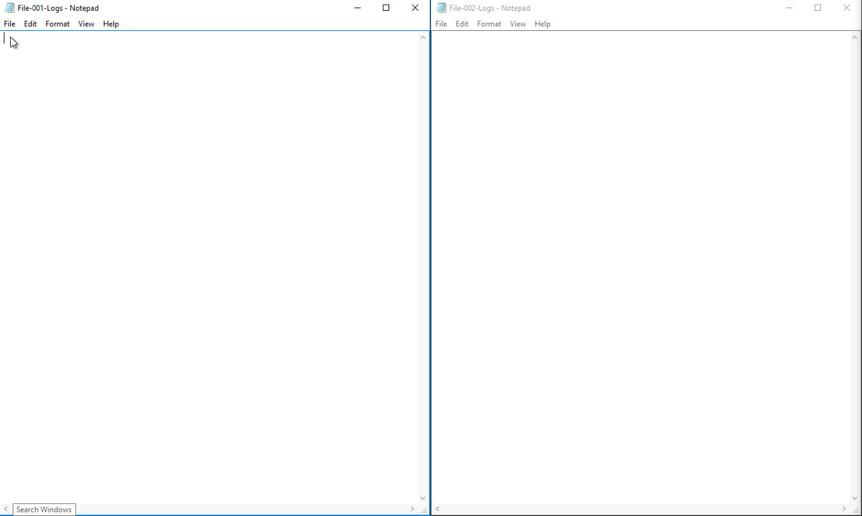
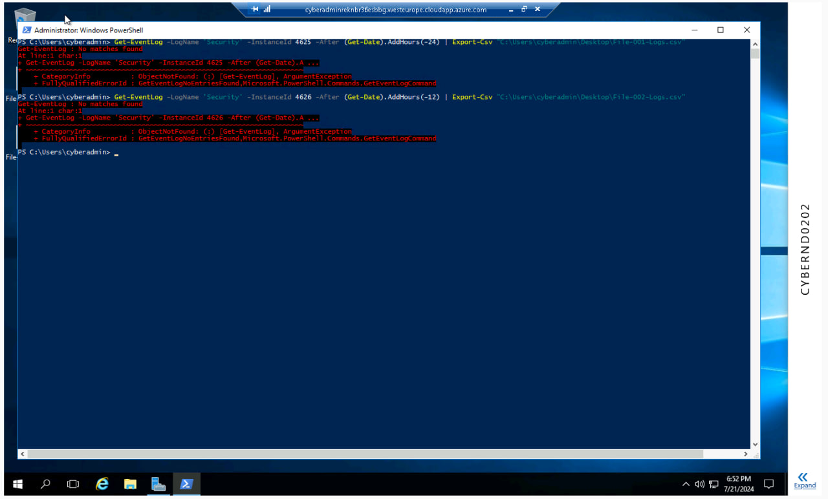
8. Logging RDP Attempts - Evidence
Place your screenshot below.

Slide 20
8. Logging RDP Attempts - Evidence
Write your 3-5 sentence explanation of your findings, recommendations, and justifications to the IT manager below.
 | There doesn’t appear to be any failed/successful attempts to our files recently. Although, when this happens we must use a tool to alert IT when a login is attempted, if there is anything suspicious (off-hours/holidays, different geolocation) then we must act because it jeopardizes our confidentiality

Slide 21
9. Windows Update - Instructions and Evidence
Using NIST 800-40r3 and Microsoft Security Update Guide, analyze the windows servers and provide your answers in the table below of available updates (KB and CVE) that should be installed as well as any updates that can be safely ignored for DFI's purpose. To assist, be aware that DFI is concerned with stability and security, any update that is not labeled as a 'critical' or 'security' can be left off. In the table below list at least 3 updates that should be installed and 3 updates that are not necessary.Justify your recommendations as to why you are making your choices. Tip: The severity of the updates can also help you decide the updates you’d like to install or ignore.
 | Available Updates | Update or Ignore? | Justification
 | KB5040434 | Update | This update includes security improvements and quality enhancements.
 | KB5039214 | Update | Provides security updates and stability improvements.
 | KB5033373 | Update | Addresses security vulnerabilities and enhances system reliability.
 | KB5037926 | Ignore | Related to .NET, not important to security
 | KB5034119 | Ignore | Not related to security.
 | KB5035855 | Ignore | Again, not related to security.

Slide 22
10. Firewall Alert Response - Instructions and Evidence
The IT Manager took a look at firewall alerts and was concerned with some traffic she saw, please take a look and provide a mitigation response to the below firewall report. Remember to justify your mitigation strategy in 3 - 5 sentences. This file is available from the project resources title: DFI_FW_Report.xlsx. Please download and use this file to complete this task.
1 | Firewall mitigation response and justification goes here We should whitelist our own IP addresses to use SSH but block any other SSH traffic on our network from not already whitelisted ones, this ensures that we can safely access our servers via SSH (especially for work from home) but anyone else will be blocked at the firewall.

Slide 23
11. Status Report and Next Steps - Instructions
As your first two weeks wind down, the IT Manager, HR Manager as well as other management are interested in your experience. With your position being the first dedicated Information Security role, they would like a 'big picture' view of what you've done as well as the security posture of DFI. Similar to Defense-in-Depth, an organization has multiple layers of security from the edge of their web presence all the way to permissions on a file. In 6-8 sentences, explain the work you've done, the recommendations made and how DFI should proceed from a security standpoint. This is your opportunity to provide a thoughtful analysis that shows your understanding of Cyber Security and how all of the tasks you've performed contribute to the security of DFI. As this will be reviewed by non-technical management please keep the technical jargon to a minimum. [Provide your Status Report on the next slide.]

Slide 24
12. Status Report and Next Steps - Instructions
[Provide your Status Report below.]
1 | My main goal is to improve DFI’s security, I managed to protect our employee’s confidentiality, protect us from attacks which would’ve greatly damaged our availability to our customers, I’ve recommended innovative and new solutions that top security companies are using right now, and I think DFI, being in the financial market, should invest heavily into its security, innovative solutions come at a cost, but it is much smaller than that incurred by cyberattacks.

Slide 25
13. File Encryption
As your final task, assemble all of the deliverables you have created in Steps 1-12 and encrypt them using 7zip with a strong password. Password complexity: 15 or more characters and a combination of alphanumerics and special characters. When you submit the file you must also include your password as a note to the reviewer at Udacity or they will not be able to review your project.

Slide 26
Standout Suggestions

Slide 27
Standout Suggestion 1
Older OS installations
1 | Our servers should be migrated to Windows Server 2022, despite Windows Server 2016 being widely used and still receiving security updates, Microsoft is not as attentive as needed with older versions, upgrading will likely improve security.

Slide 28
Standout Suggestion 2
Heavy reliance on remote solutions
2 | DFI allows RDP connections and SSH into their servers from outside their networks, although security can be toughened, it massively increases the attack surface, DFI must decide whether the luxury of work-from-home is as important as security, but if they want both they’ll have to pay for more secure solutions in the future.

